Slide 1
SU-19-02_SP-78-07 San Juan, Siquijor

Slide 2
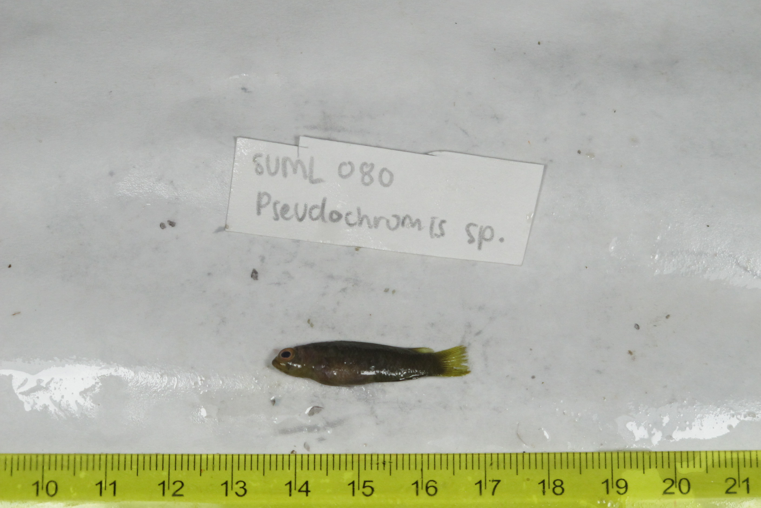
SU-19-02_029 (SUML-080) Original ID: Pseudochromis sp. Jeff’s ID:

Slide 3
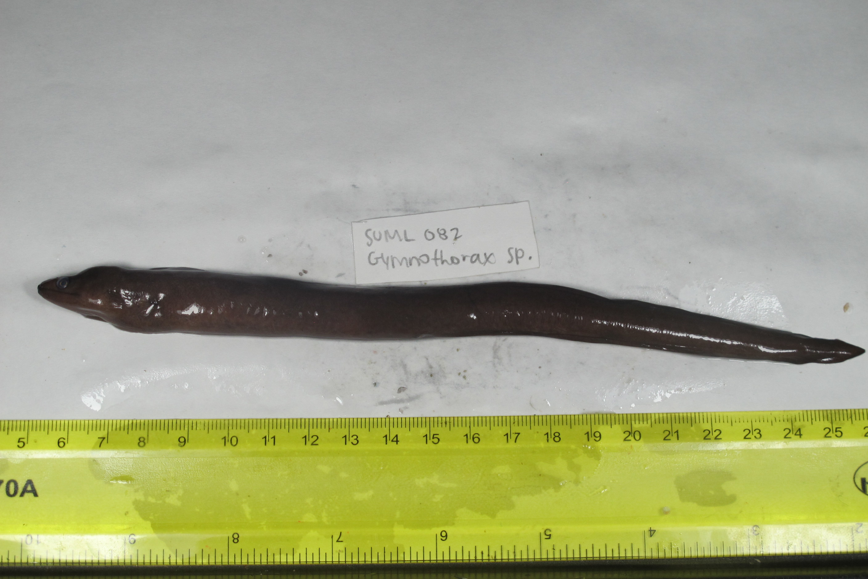
SU-19-02_031 (SUMO-082) Original ID: Gymnothorax sp. Jeff’s ID:

Slide 4
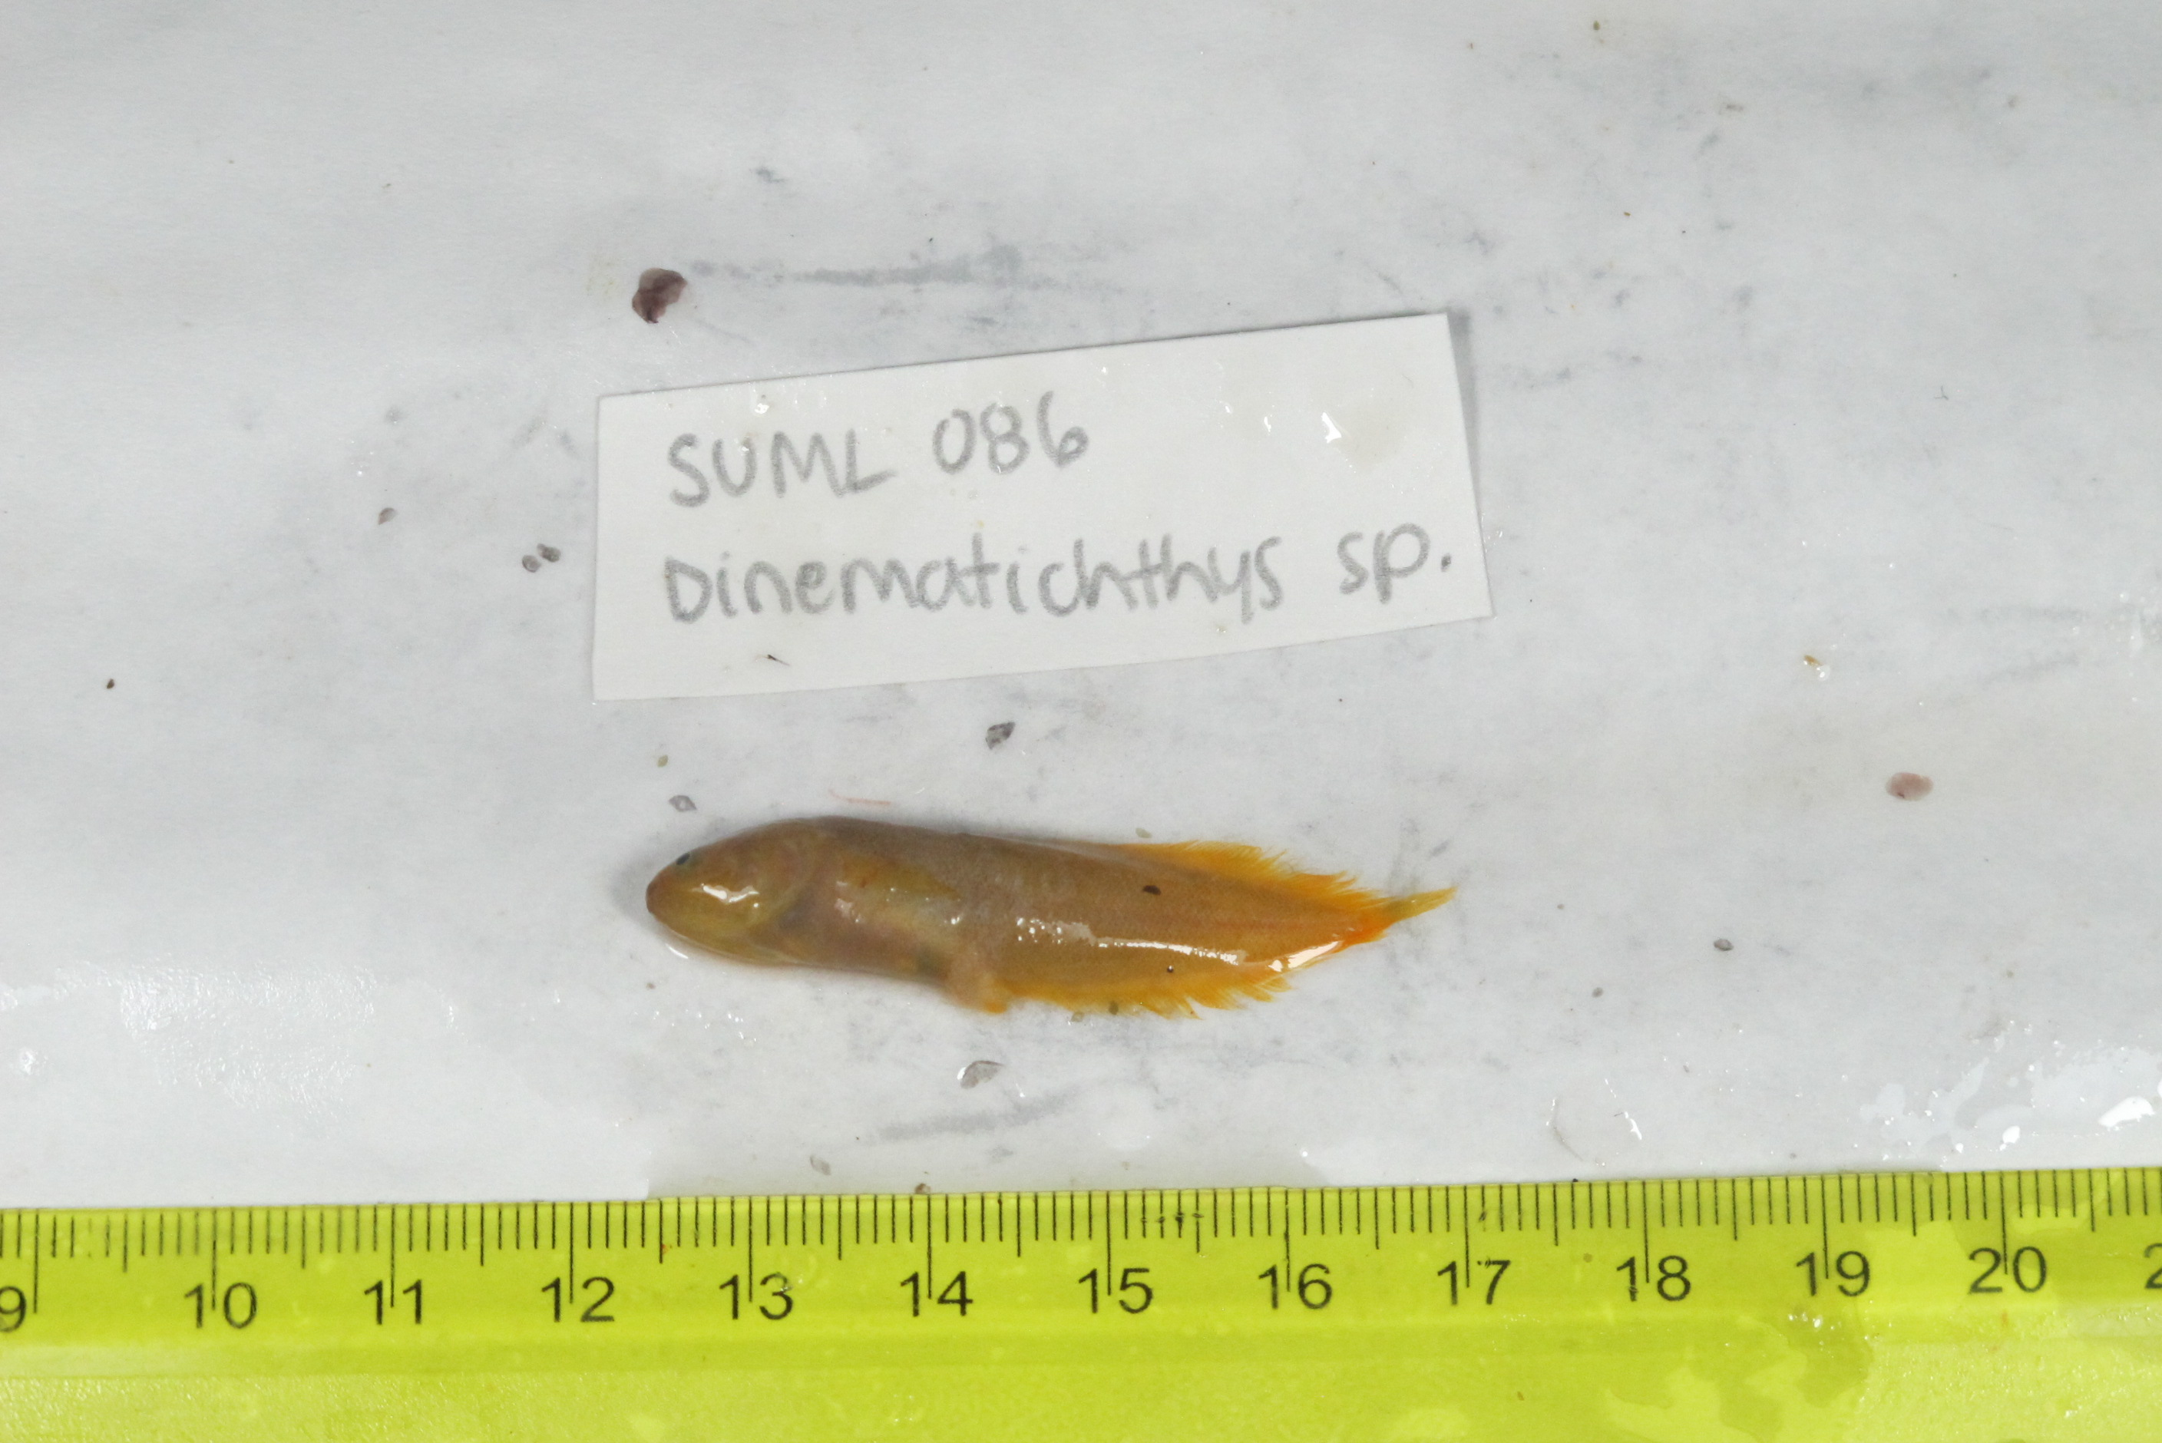
SU-19-02_035 (SUML-086) Original ID: Dinematichthys sp. Jeff’s ID:

Slide 5
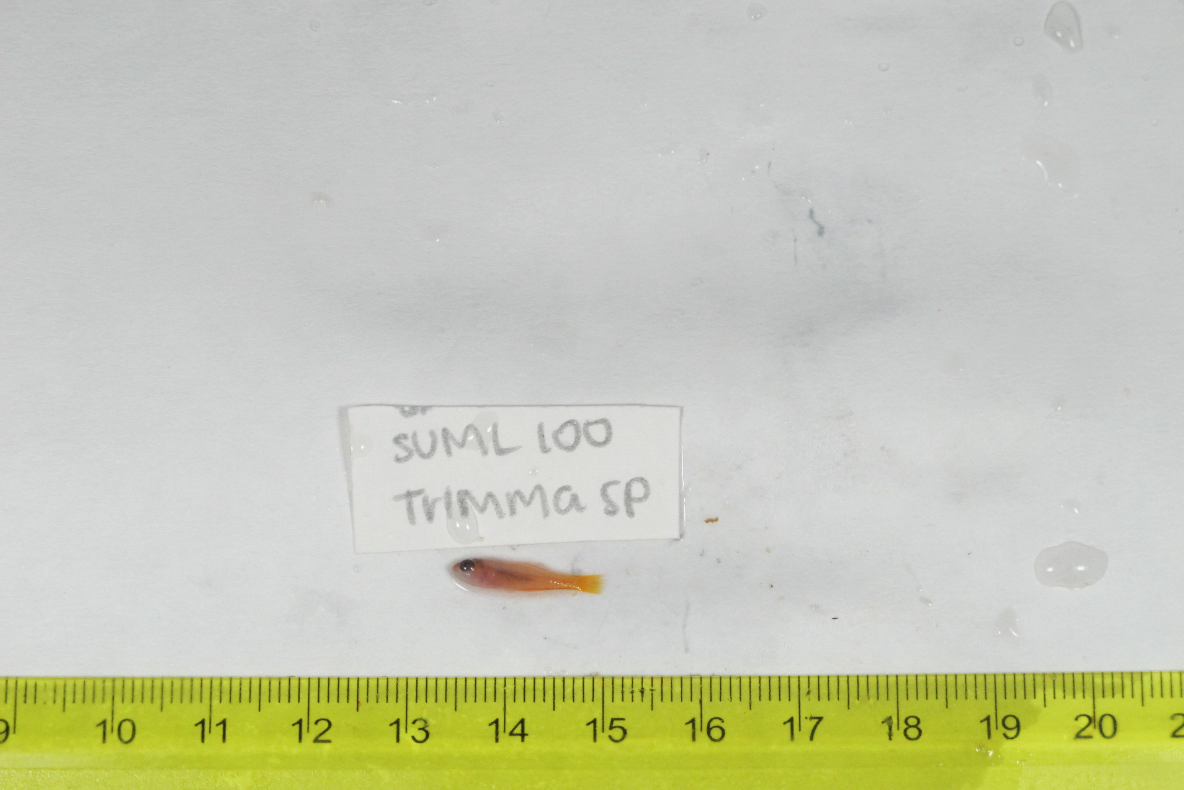
SU-19-02_049 (SUML-100) Original ID: Trimma sp. Jeff’s ID:

Slide 6
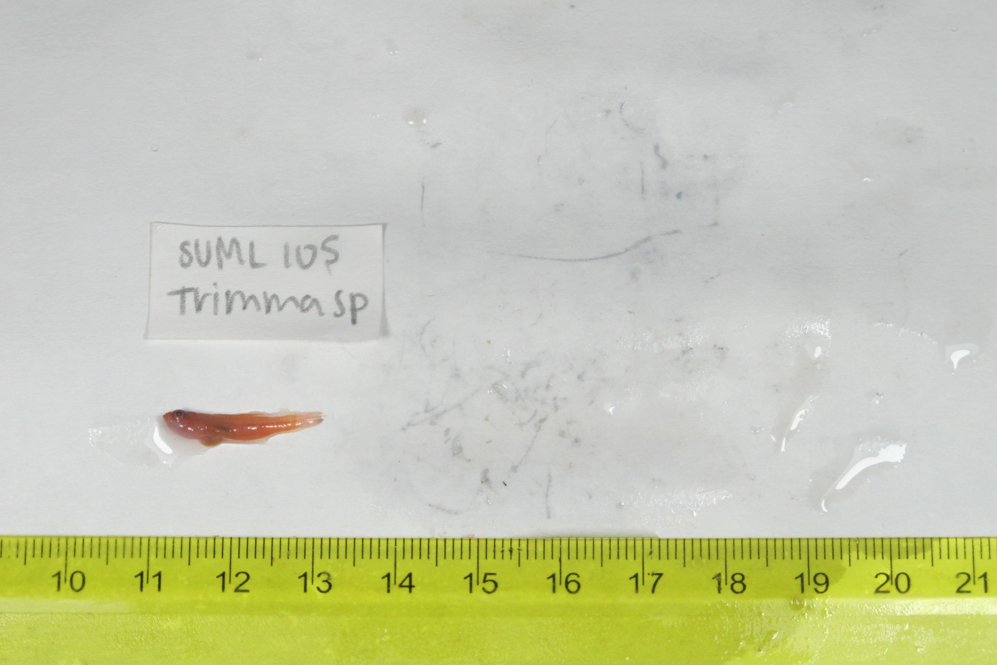
SU-19-02_054 (SUML-105) Original ID: Trimma sp. Jeff’s ID:

Slide 7
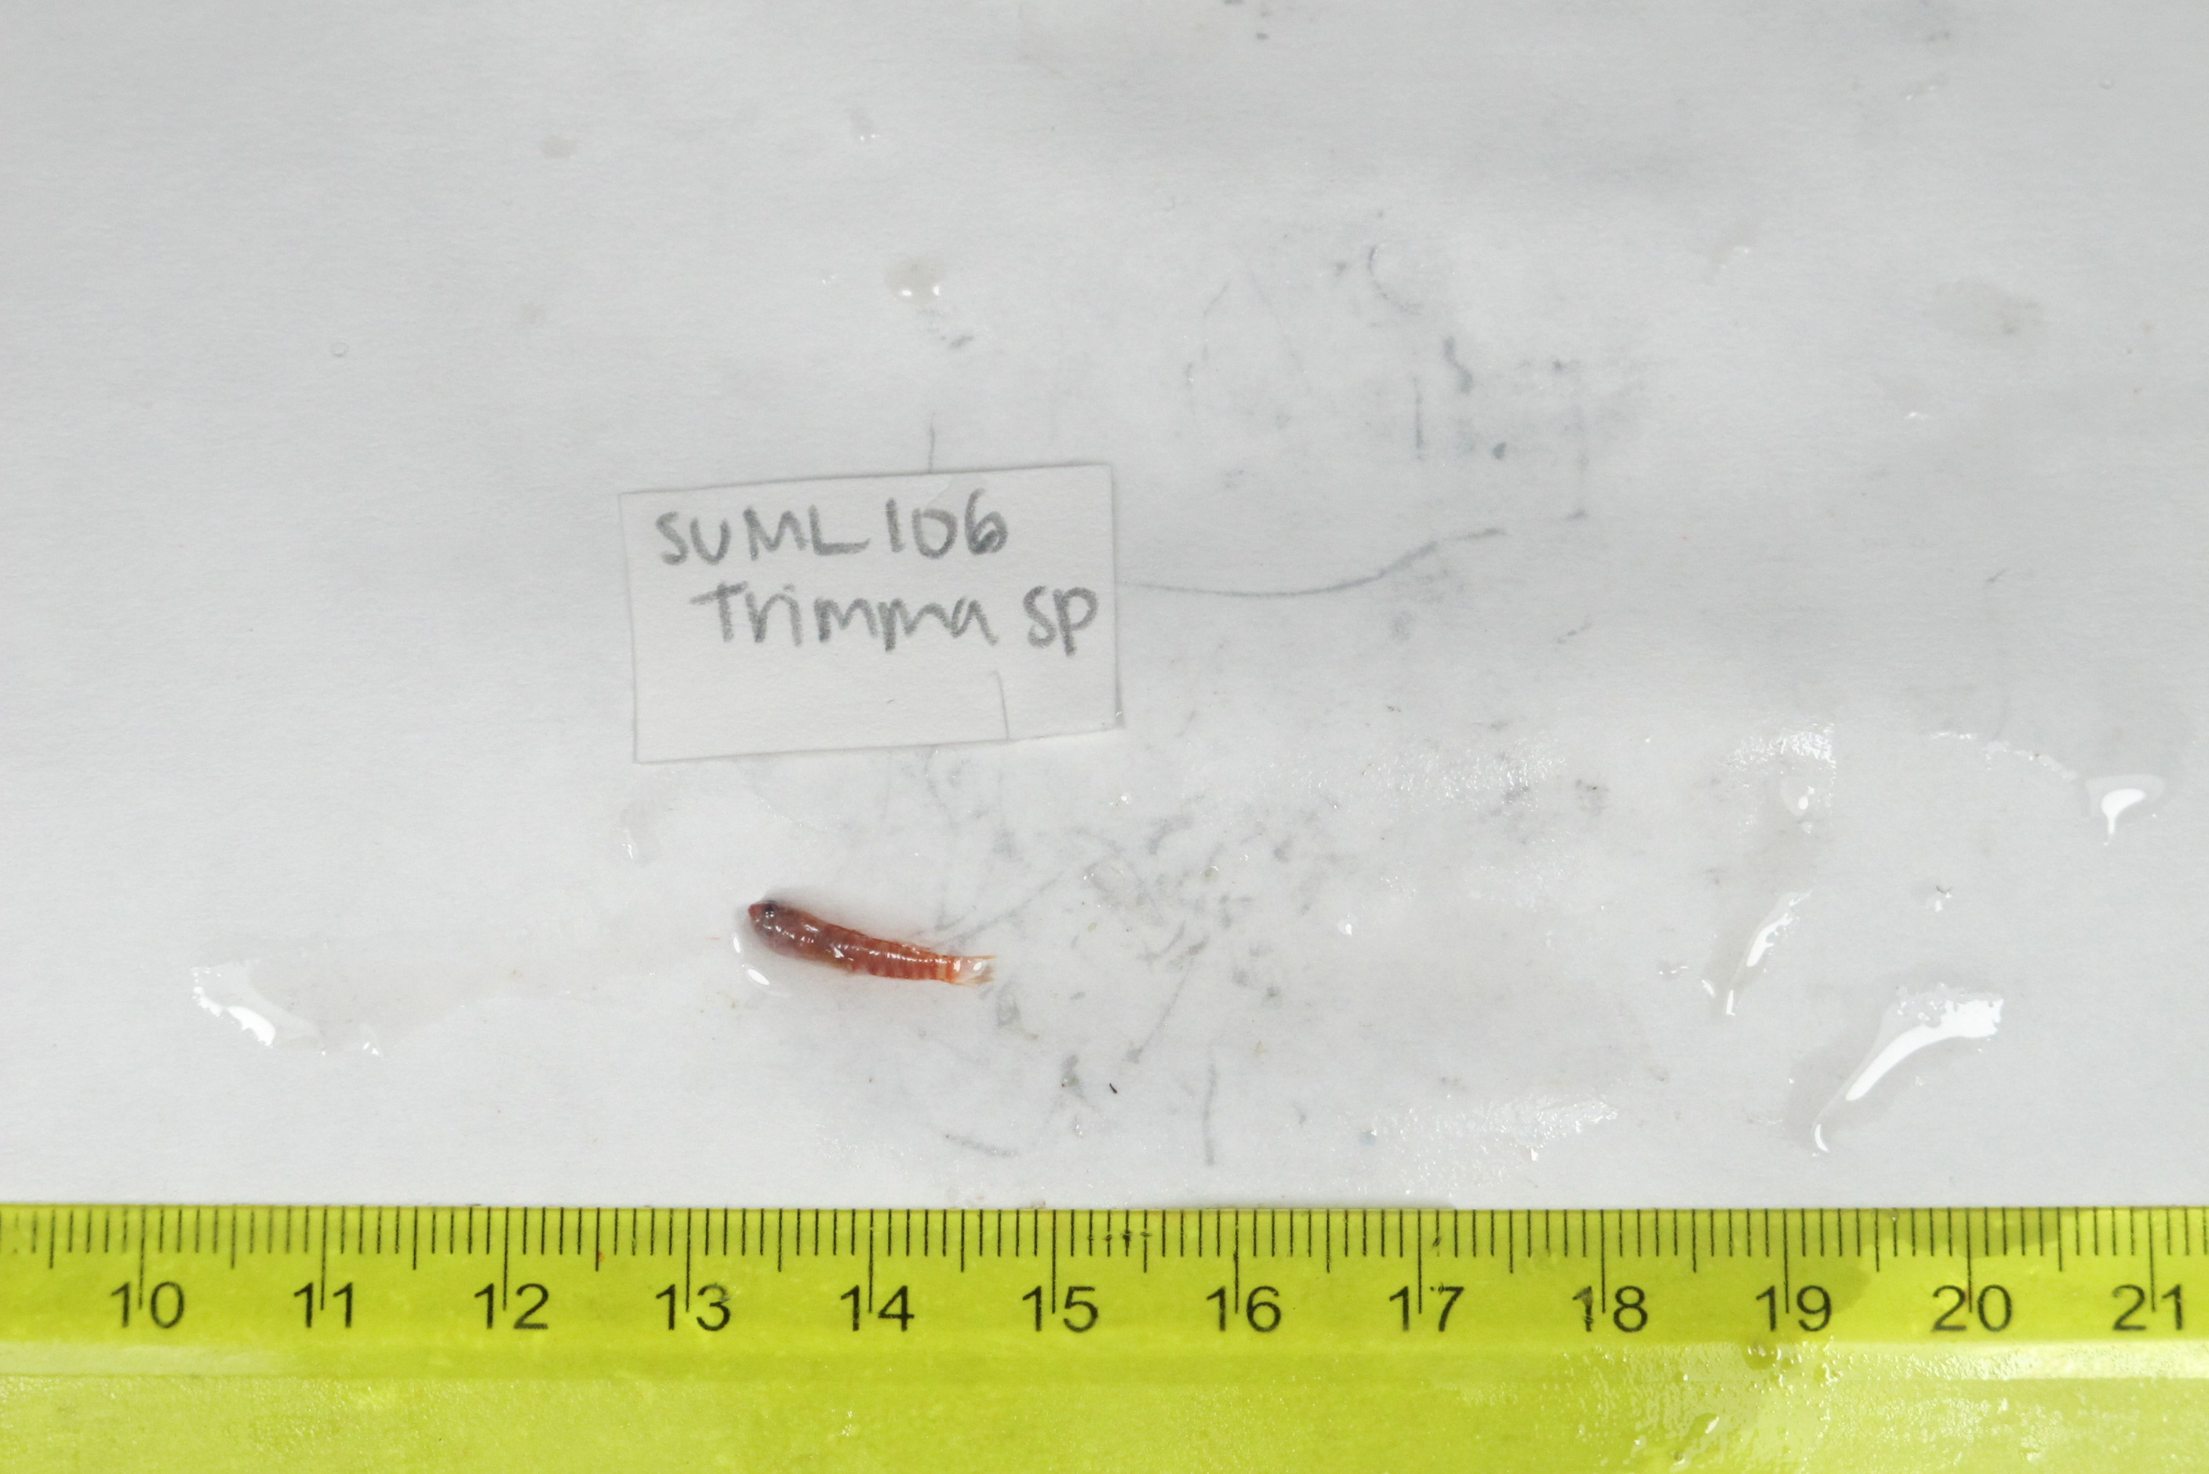
SU-19-02_055 (SUML-106) Original ID: Trimma sp. Jeff’s ID:

Slide 8
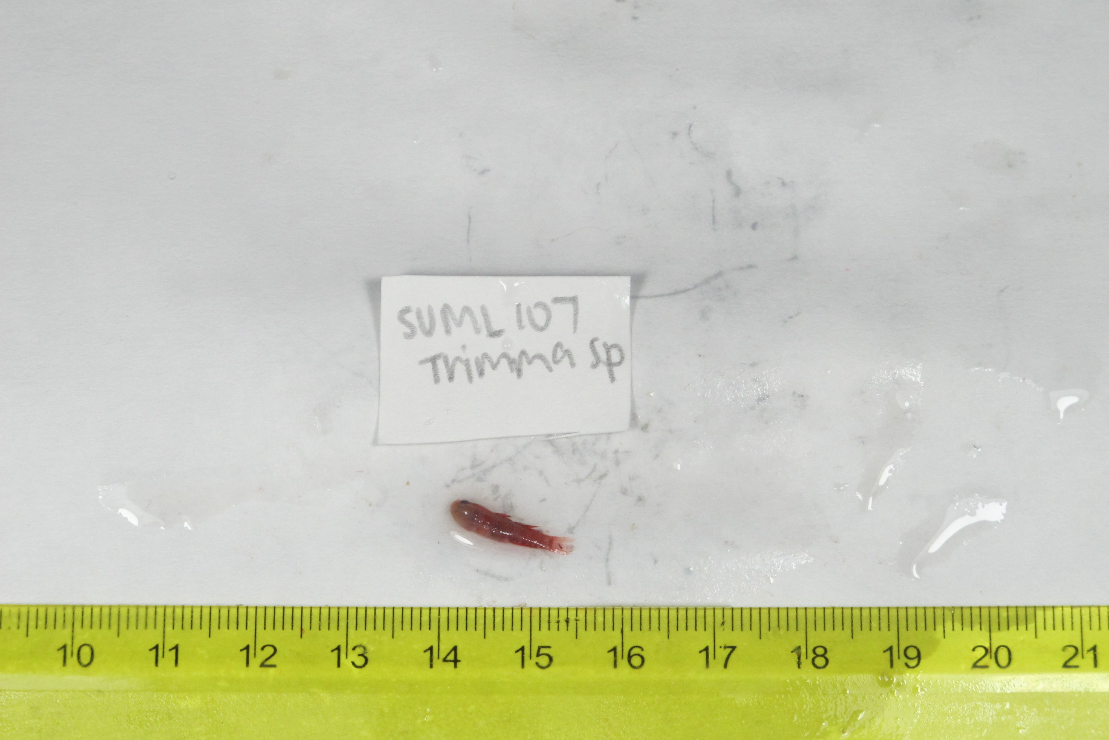
SU-19-02_056 (SUML-107) Original ID: Trimma sp. Jeff’s ID:

Slide 9
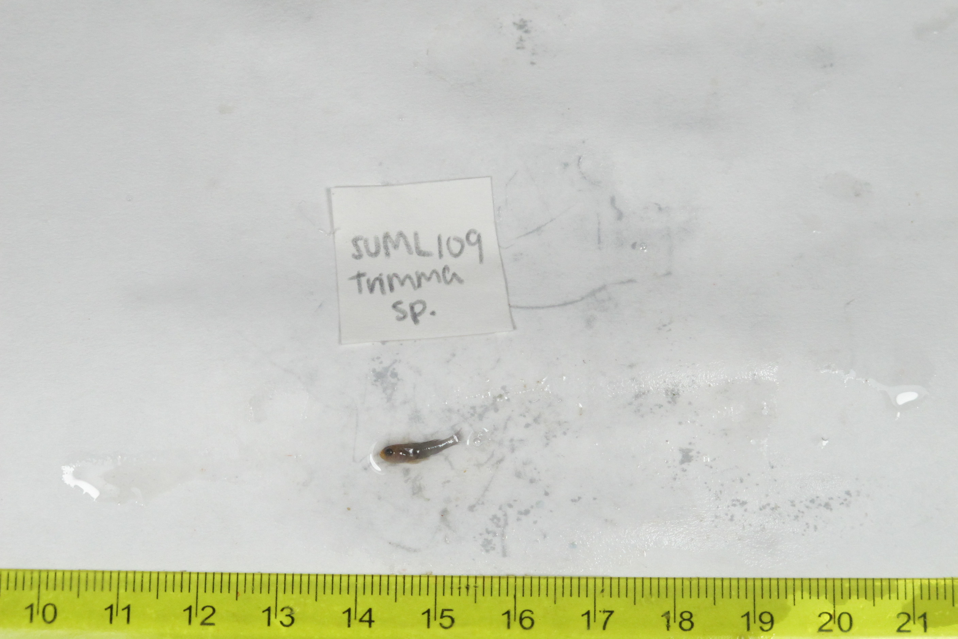
SU-19-02_058 (SUML-109) Original ID: Trimma sp. Jeff’s ID:

Slide 10
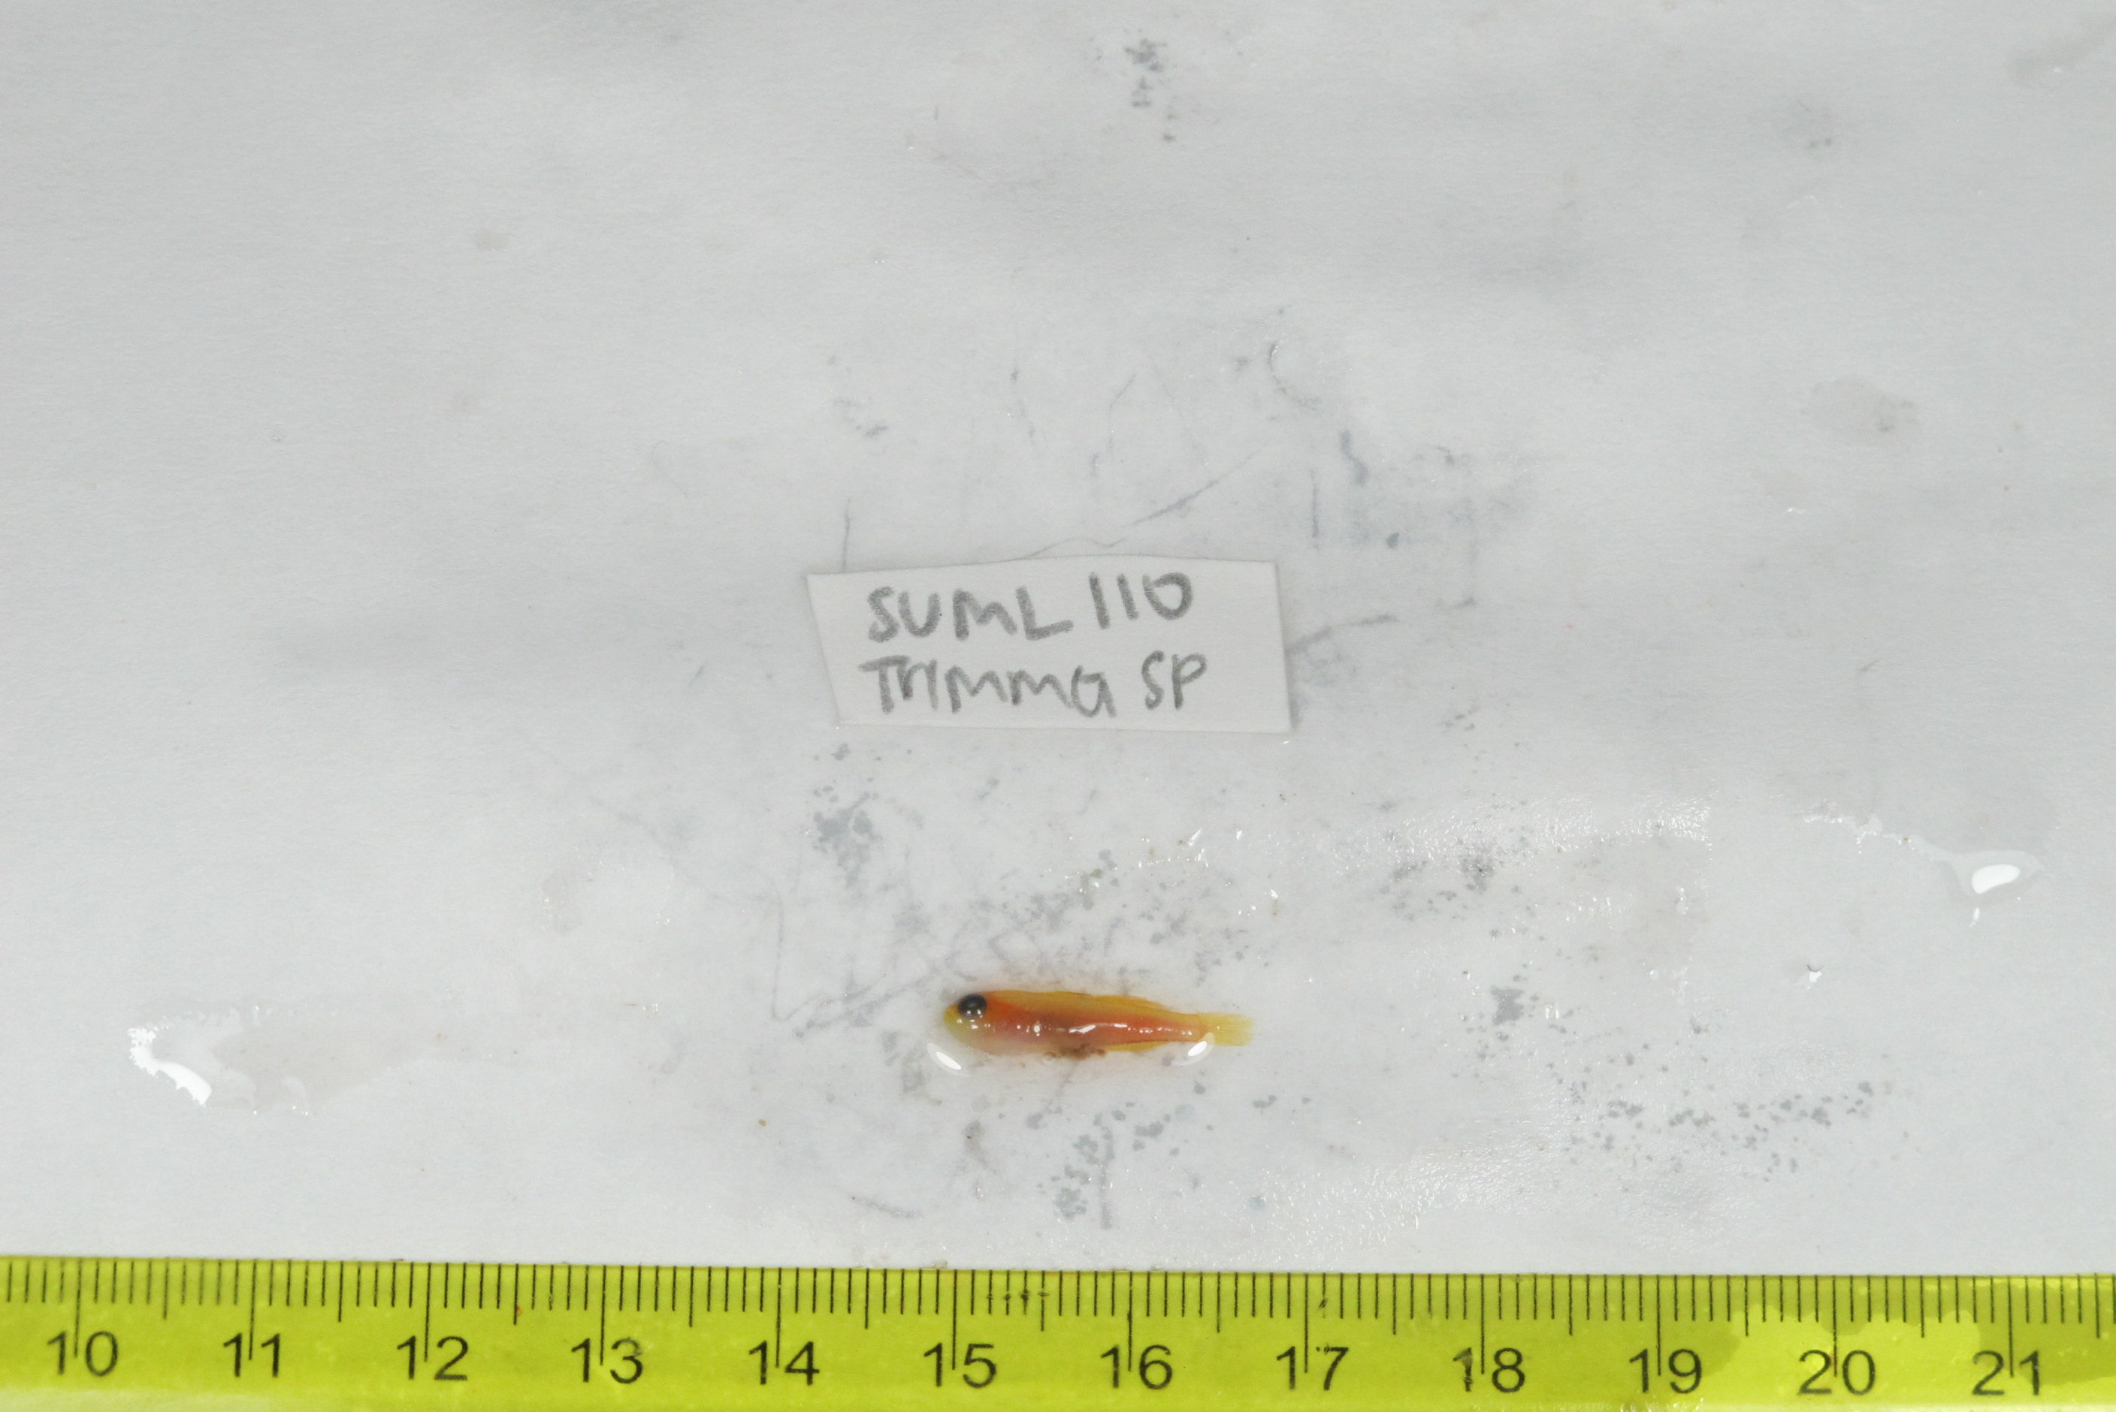
SU-19-02_059 (SUML-110) Original ID: Trimma sp. Jeff’s ID:

Slide 11
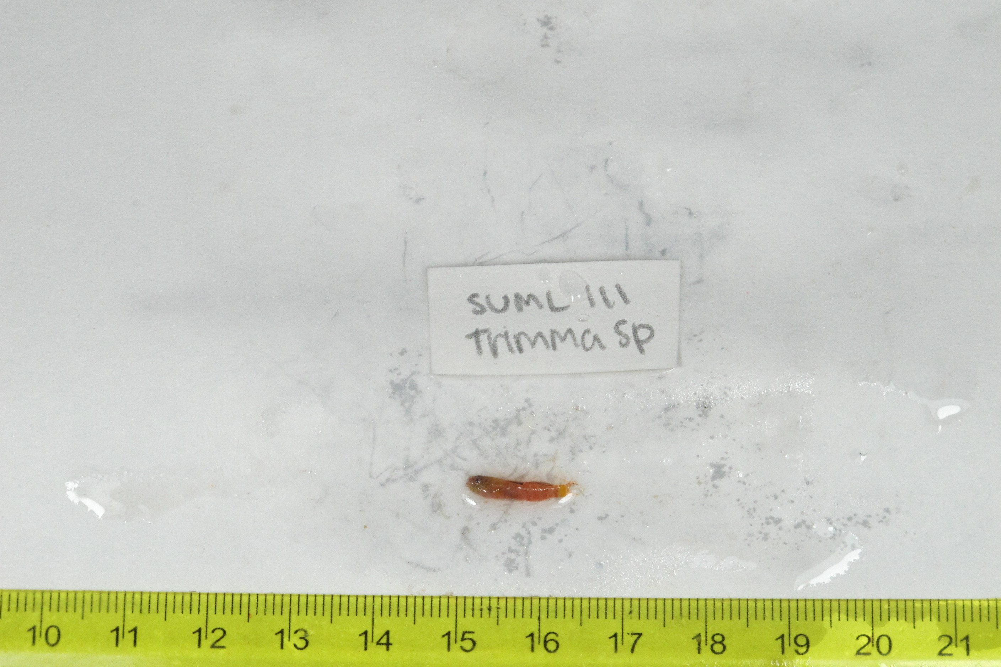
SU-19-02_060 (SUML-111) Original ID: Trimma sp. Jeff’s ID:

Slide 12
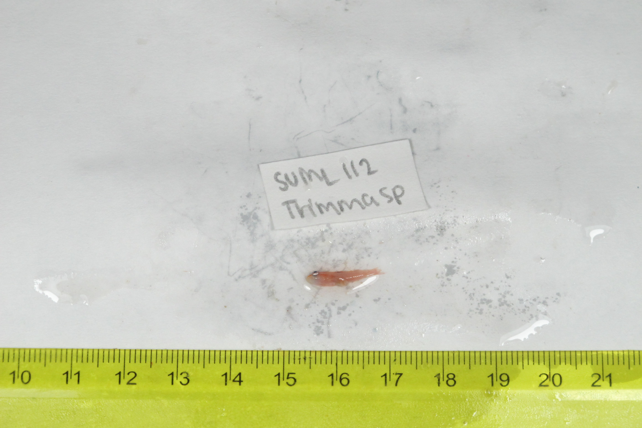
SU-19-02_061 (SUML-112) Original ID: Trimma sp. Jeff’s ID:

Slide 13
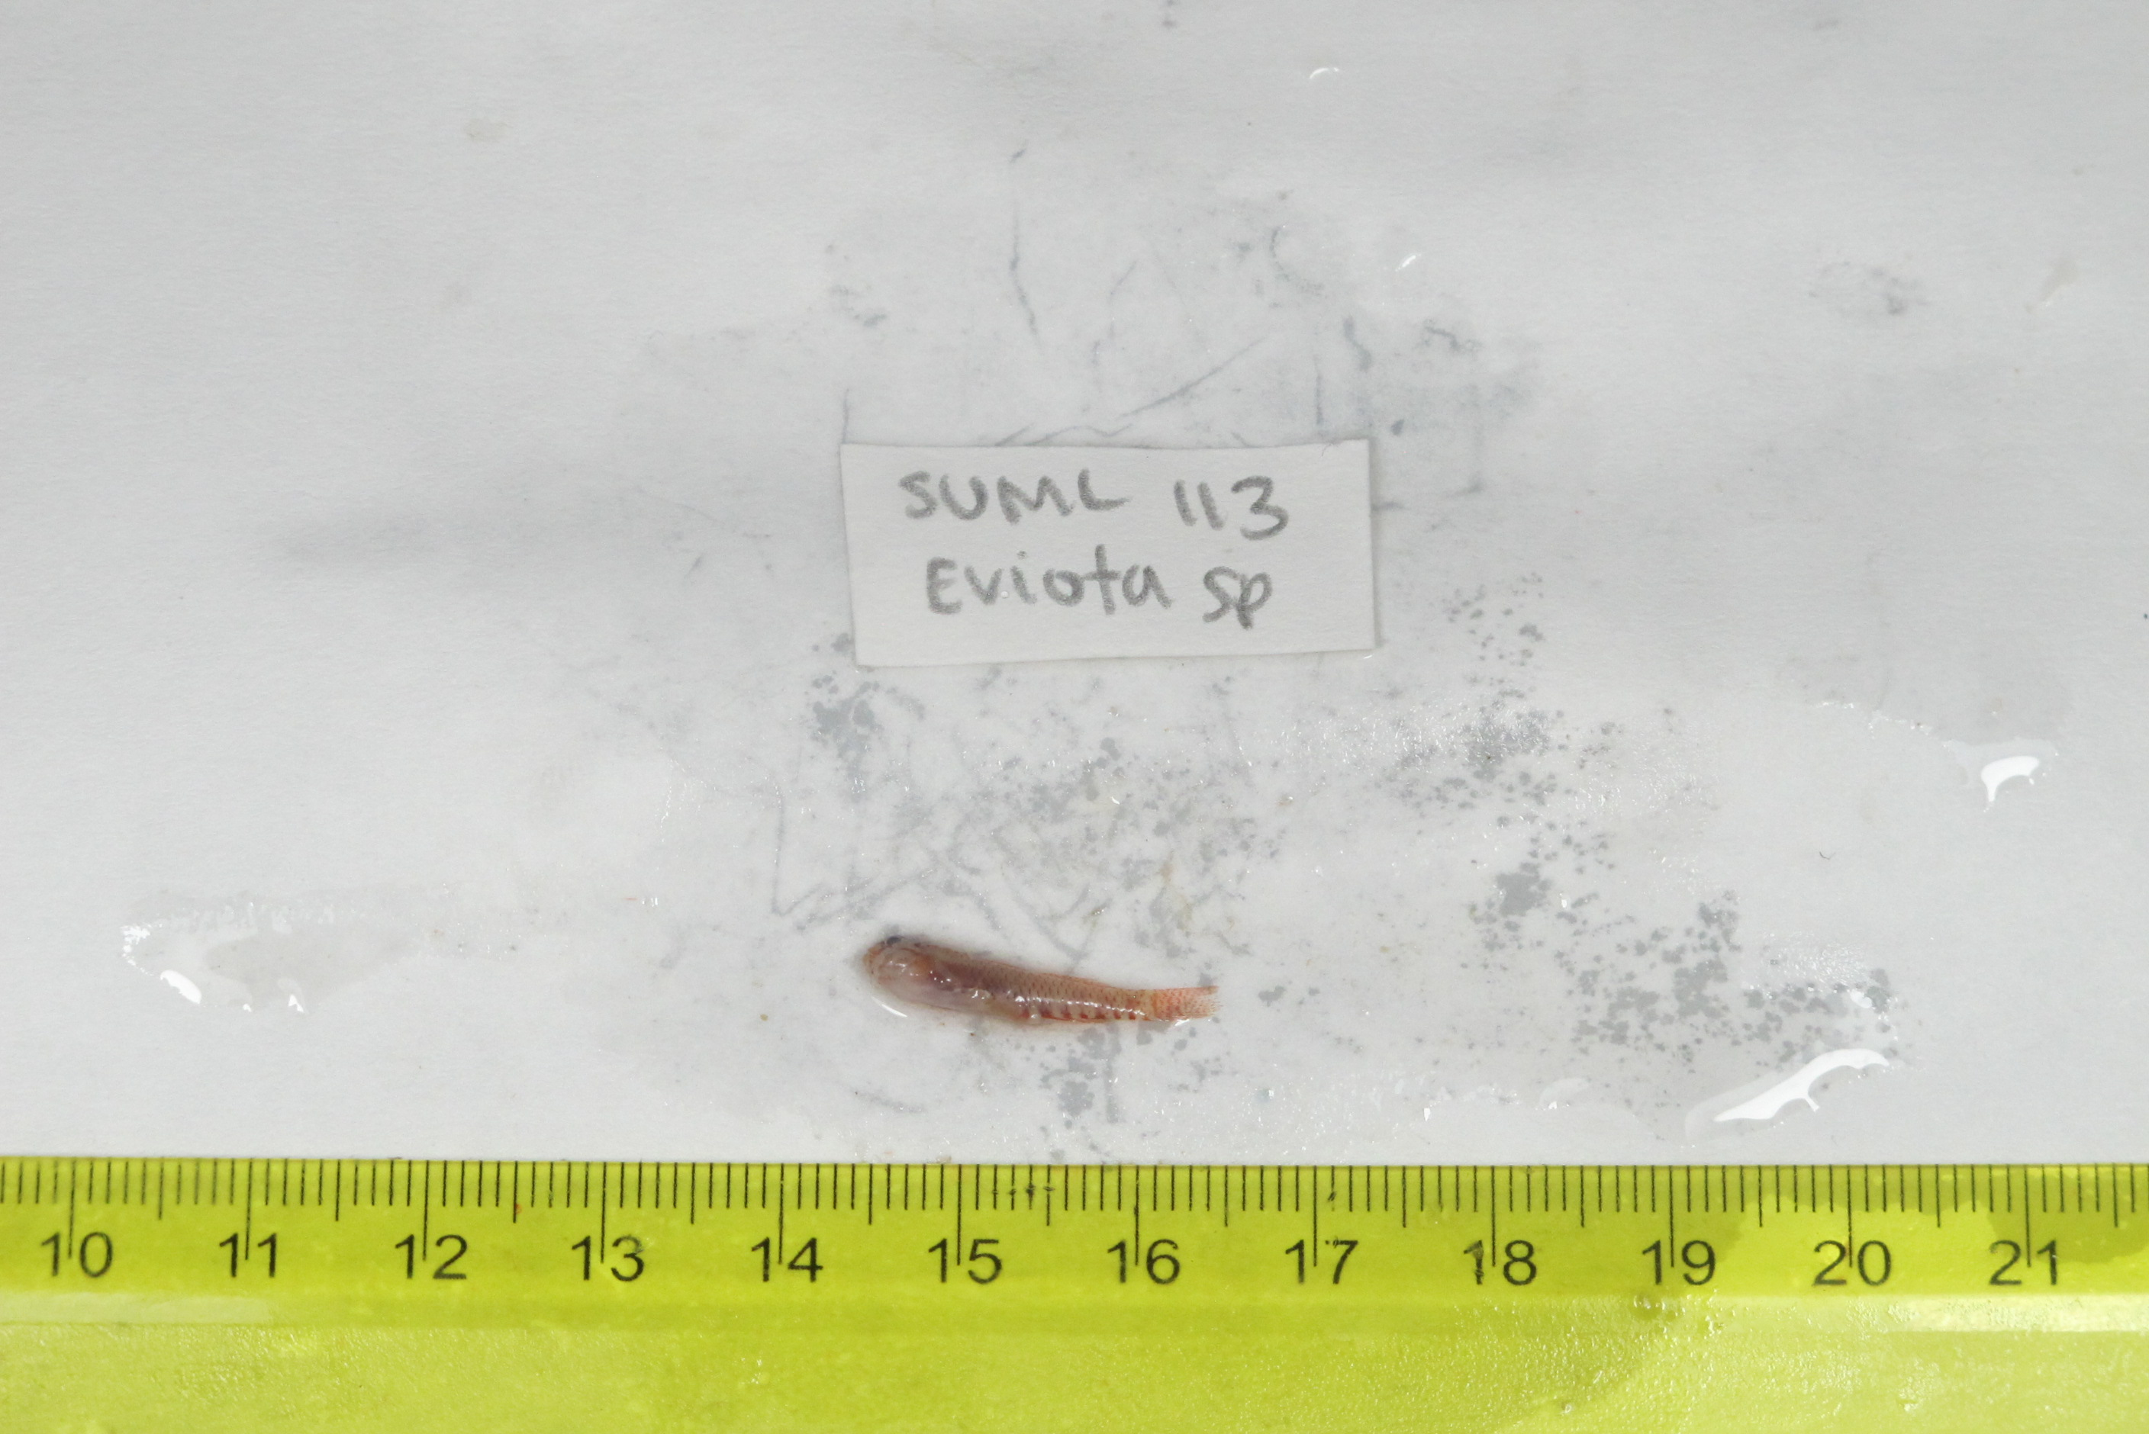
SU-19-02_062 (SUML-113) Original ID: Eviota sp. Jeff’s ID:

Slide 14
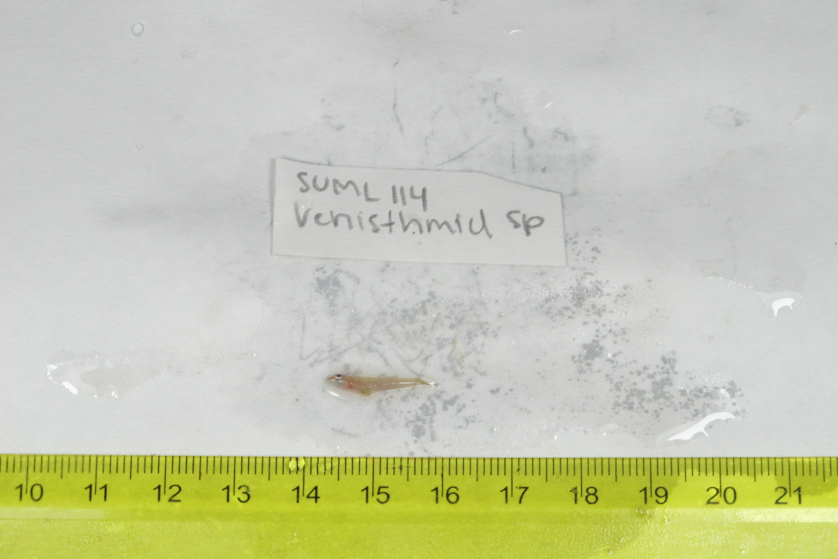
SU-19-02_063 (SUML-114) Original ID: Xenisthmid sp. Jeff’s ID:

Slide 15
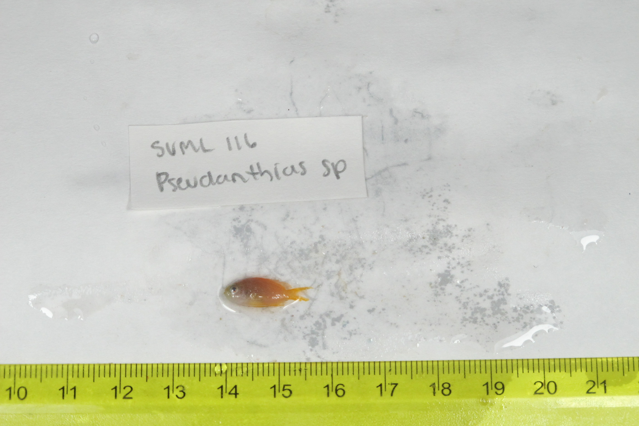
SU-19-02_065 (SUML-116) Original ID: Pseudanthia sp. Jeff’s ID:

Slide 16
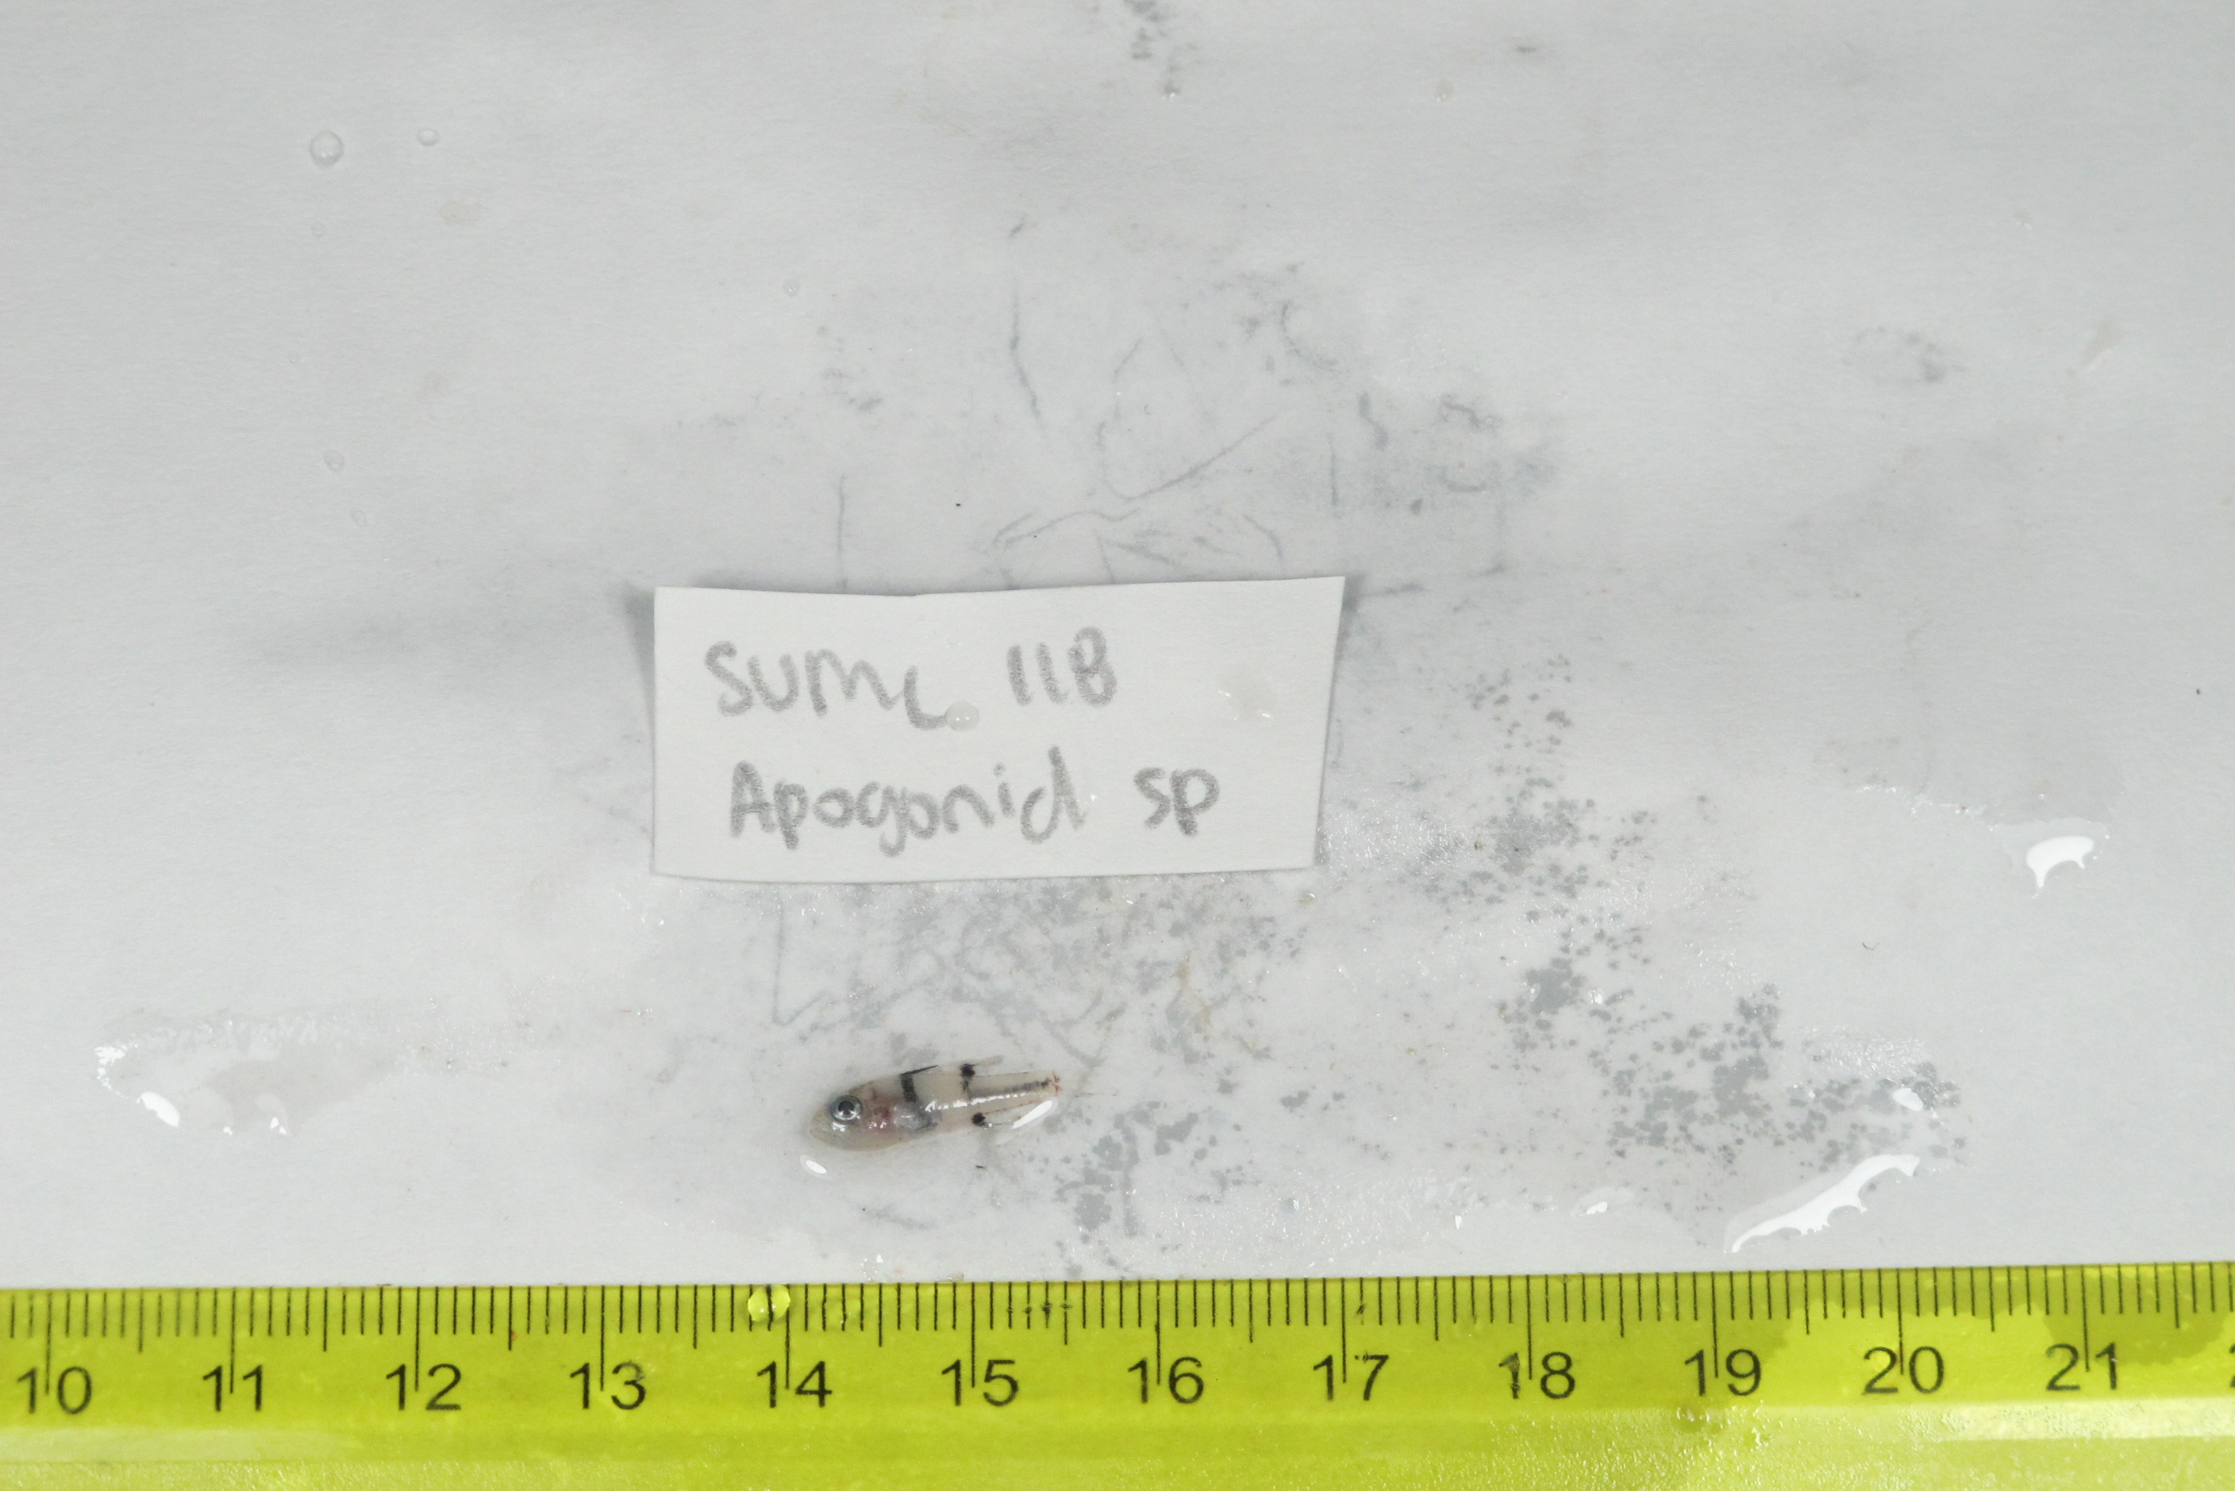
SU-19-02_067 (SUML-118) Original ID: Apogon sp. Jeff’s ID:

Slide 17
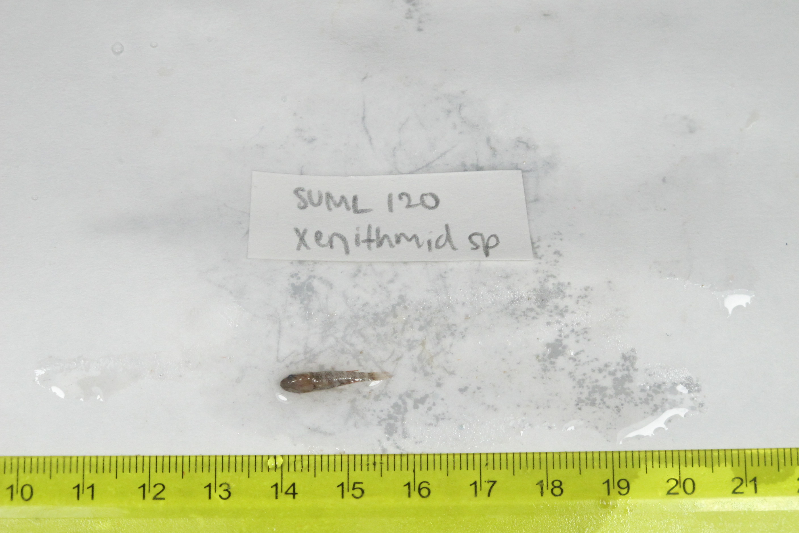
SU-19-02_069 (SUML-120) Original ID: Xenisthmid sp. Jeff’s ID:

Slide 18
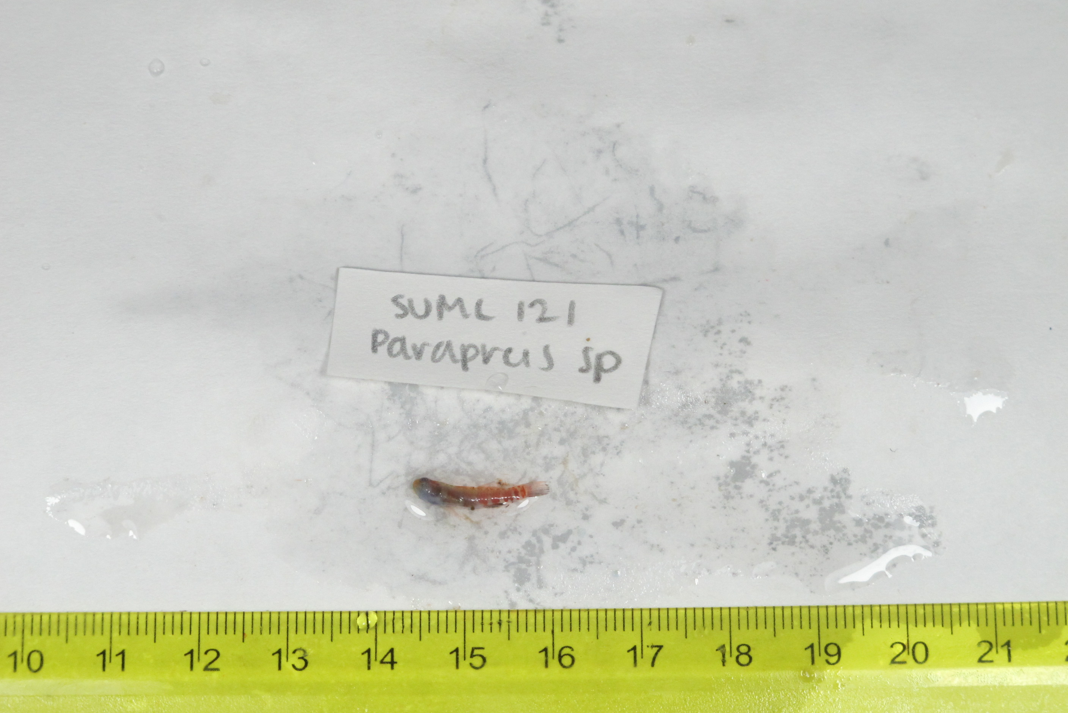
SU-19-02_070 (SUML-121) Original ID: Parapercis sp. Jeff’s ID:

